Slide 1

CHANGE MANAGEMENT
Innovative governance • sustainable development • community services • citizen satisfaction
Citizen
Governance
Climate
SDGs
DRR
Digital
Community
Training for newly recruited Class-II Officers • Government of Bihar • October 2026
By
Prof Anil Kumar
Professor of Practice | NITTTR Kolkata (Deemed University under Ministry of Education, GoI)
Mob: 9007560314 | Email: kranil01011962@gmail.com

Slide 2
Learning Outcomes
2
ORIENTATION
Explain change management in the context of public administration.
Diagnose why public-sector change succeeds or fails.
Apply Kotter, ADKAR, Lewin and stakeholder tools to real administrative challenges.
Connect local decisions with Paris Agreement, SDGs and Sendai Framework.
Design citizen-centric, climate-resilient and measurable change initiatives.
Build a 90-day action plan for the first posting.
Explain
Plan
Diagnose
CHANGE
LEADER
Design
Apply
Connect
APPLY • MEASURE • LEARN • SUSTAIN
Prof Anil Kumar | NITTTR | Training for Class-II Officers, Government of Bihar

Slide 3
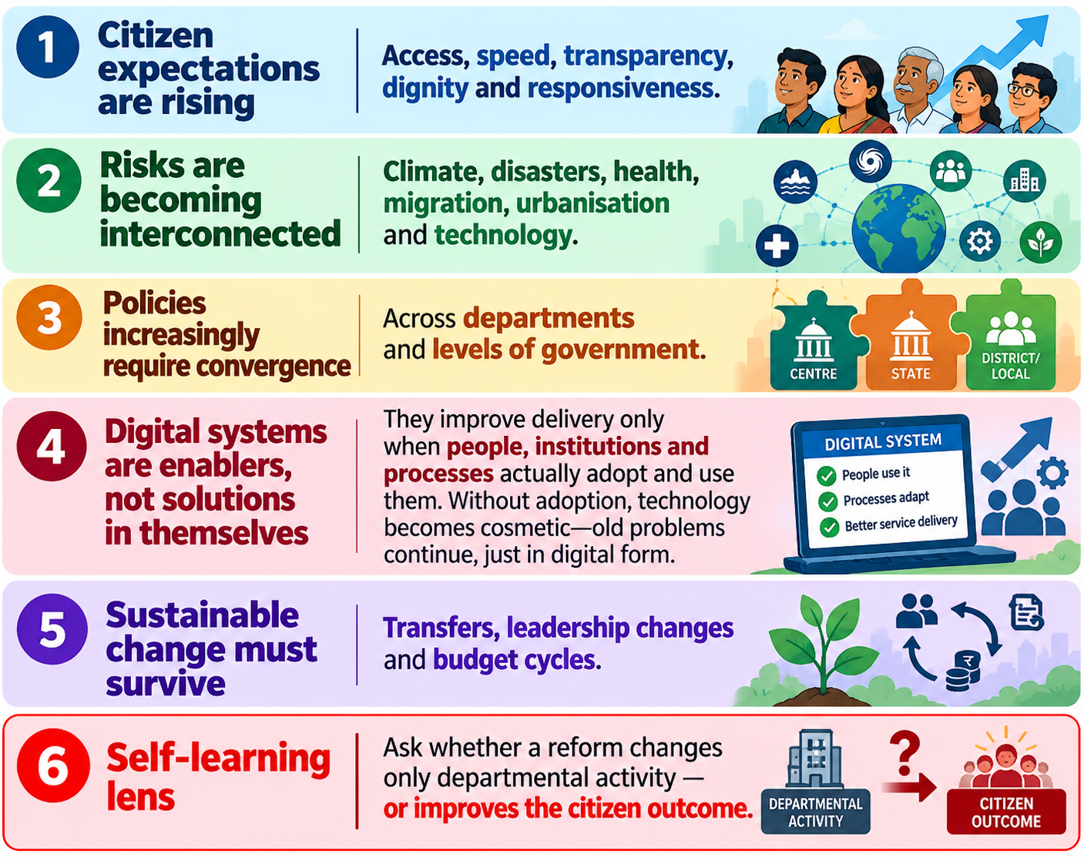
Why Change Management Matters in Government
3
WHY CHANGE
ADMINISTRATIVE ACTIVITY
Citizen expectations are rising: access, speed, transparency, dignity and responsiveness.
Risks are becoming interconnected: climate, disasters, health, migration, urbanisation and technology.
Policies increasingly require convergence across departments and levels of government.
Digital systems are enablers, not solutions in themselves. They improve delivery only when people, institutions, and processes actually adopt and use them. Without adoption, technology becomes cosmetic—old problems continue, just in digital form.
Sustainable change must survive transfers, leadership changes and budget cycles.
Self-learning lens: ask whether a reform changes only departmental activity - or improves the citizen outcome.
PUBLIC OUTCOME
1
1
Funds released
Service reached
2
→
2
Training held
Problem solved
3
3
Portal launched
Trust improved
Prof Anil Kumar | NITTTR | Training for Class-II Officers, Government of Bihar
APPLY • MEASURE • LEARN • SUSTAIN

Slide 4
From Administration to Public Value
4
WHY CHANGE
Traditional lens: inputs → rules → activities → outputs.
Transformation lens: citizen need → co-designed service → measurable outcome → learning → continuous improvement.
Public value combines effectiveness, equity, legitimacy/trust and sustainability.
The officer’s role shifts from file processor to steward of outcomes and enabler of systems.
Citizen need
Co-design
Outcome
Learn
Improve
→
→
→
→
1
2
3
4
Effectiveness
Equity
Trust
Sustainability
Prof Anil Kumar | NITTTR | Training for Class-II Officers, Government of Bihar
APPLY • MEASURE • LEARN • SUSTAIN

Slide 5
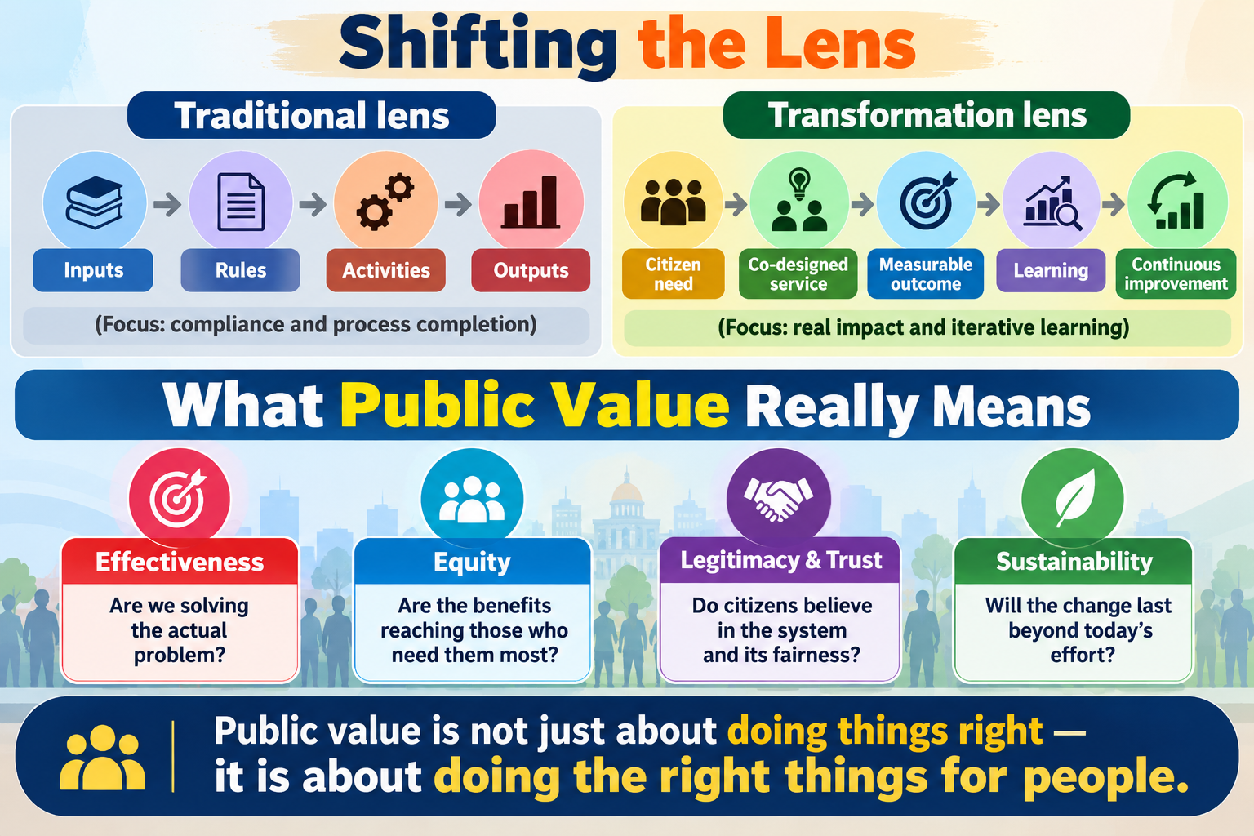
From Traditional Administration to Transformative Governance
Shifting the Lens
Traditional lens: Inputs → Rules → Activities → Outputs
(Focus: compliance and process completion)
Transformation lens: Citizen need → Co-designed service → Measurable outcome → Learning → Continuous improvement
(Focus: real impact and iterative learning)
What Public Value Really Means
Effectiveness – Are we solving the actual problem?
Equity – Are the benefits reaching those who need them most?
Legitimacy & Trust – Do citizens believe in the system and its fairness?
Sustainability – Will the change last beyond today's effort?
Public value is not just about doing things right—it is about doing the right things for people.

Slide 6
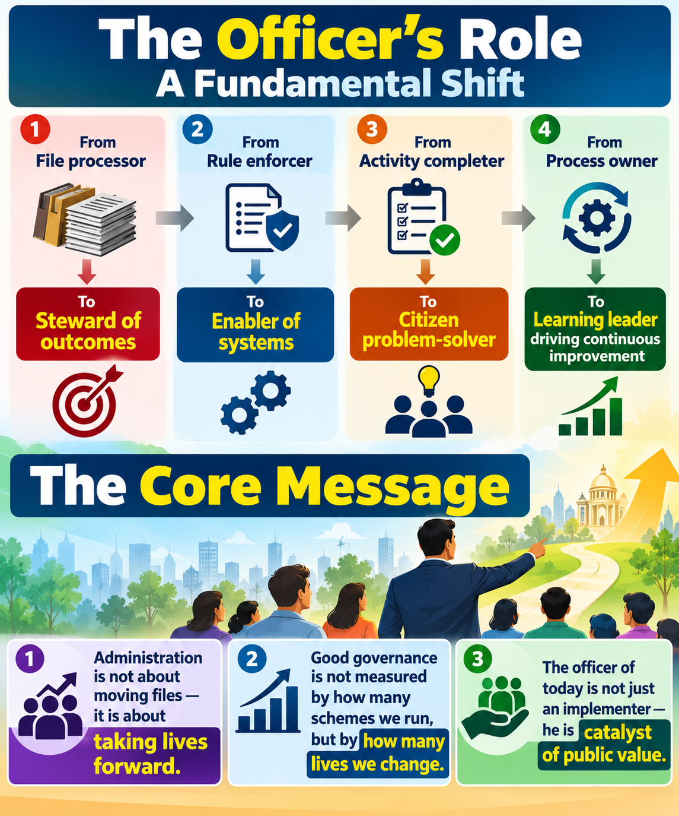
From Traditional Administration to Transformative Governance
The Officer's Role: A Fundamental Shift
From: File processor
To: Steward of outcomes
From: Rule enforcer
To: Enabler of systems
From: Activity completer
To: Citizen problem-solver
From: Process owner
To: Learning leader driving continuous improvement
The Core Message
Administration is not about moving files—it is about taking lives forward.
Good governance is not measured by how many schemes we run, but by how many lives we change.
The officer of today is not just an implementer—he is a catalyst of public value.

Slide 7
What is Change Management?
5
FOUNDATIONS
A structured approach:
  to move people, processes and institutions from a current state to a desired future state.
It addresses both:
  the technical side (policy, process, technology, resources) and
  the human side (beliefs, incentives, skills, trust and behaviour).
In governance:
  the desired state must be lawful, inclusive, resilient, transparent and citizen-centred.
Remember: technical change can be ordered; adoption must be led.
CURRENT
STATE
TRANSITION
DESIRED
STATE
→
→
1
2
3
4
People
Process
Technology
Policy
Prof Anil Kumar | NITTTR | Training for Class-II Officers, Government of Bihar
APPLY • MEASURE • LEARN • SUSTAIN

Slide 8
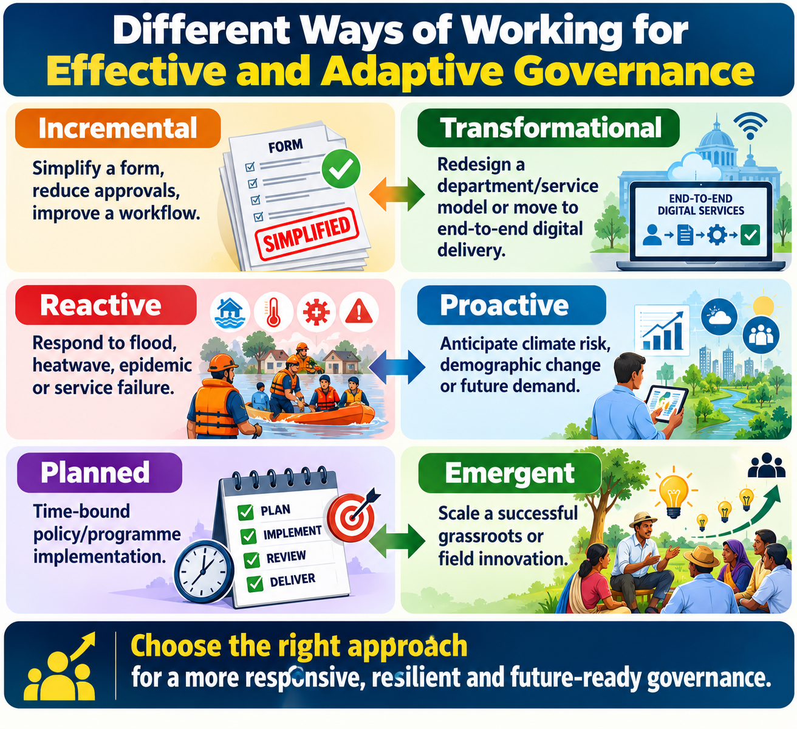
Types of Change in Public Administration
6
FOUNDATIONS
Incremental — simplify a form, reduce approvals, improve a workflow.
Transformational — redesign a department/service model or move to end-to-end digital delivery.
Reactive — respond to flood, heatwave, epidemic or service failure.
Proactive — anticipate climate risk, demographic change or future demand.
Planned — time-bound policy/programme implementation.
Emergent — scale a successful grassroots or field innovation.
1
2
Incremental
Transformational
3
4
Reactive
Proactive
5
6
Planned
Emergent
Prof Anil Kumar | NITTTR | Training for Class-II Officers, Government of Bihar
APPLY • MEASURE • LEARN • SUSTAIN

Slide 9
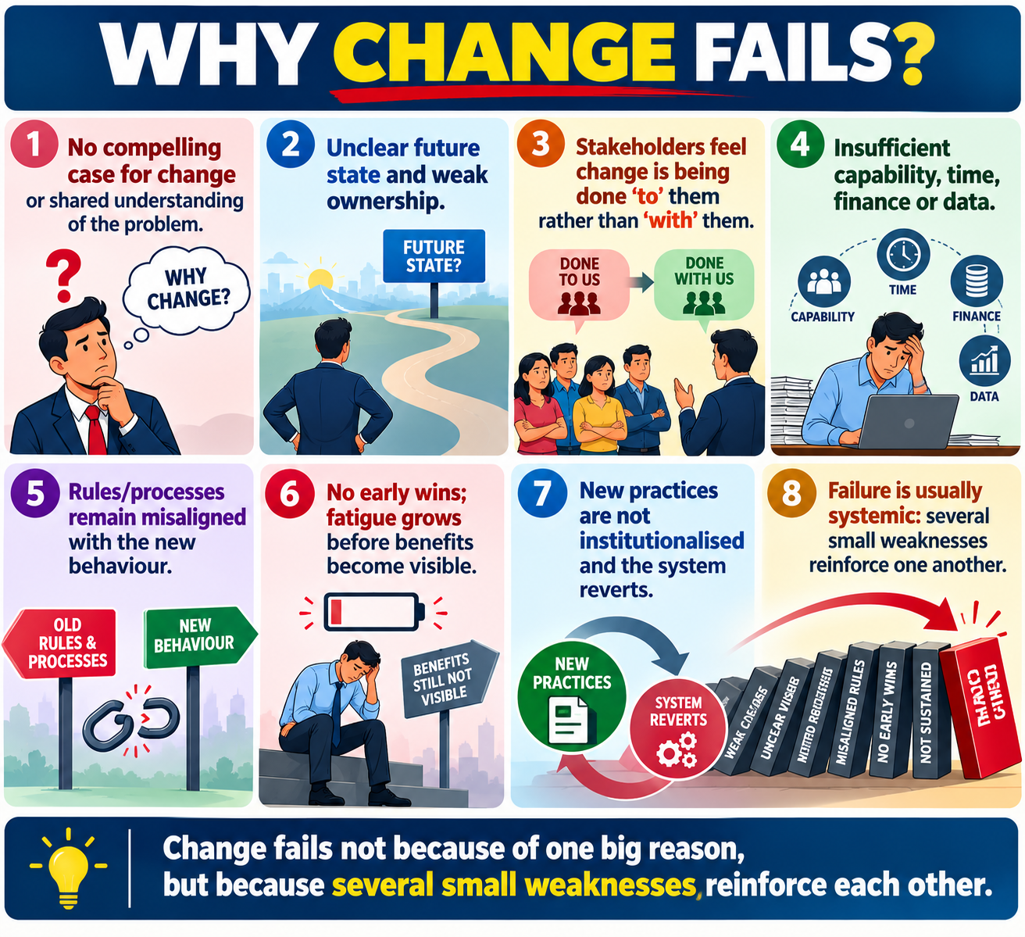
Why Change Fails
7
FOUNDATIONS
No compelling case for change or shared understanding of the problem.
Unclear future state and weak ownership.
Stakeholders feel change is being done ‘to’ them rather than ‘with’ them.
Insufficient capability, time, finance or data.
Rules/processes remain misaligned with the new behaviour.
No early wins; fatigue grows before benefits become visible.
New practices are not institutionalised and the system reverts.
Failure is usually systemic: several small weaknesses reinforce one another.
Leadership
Data
People
CHANGE
LEADER
Incentives
Process
Capacity
Prof Anil Kumar | NITTTR | Training for Class-II Officers, Government of Bihar
APPLY • MEASURE • LEARN • SUSTAIN

Slide 10
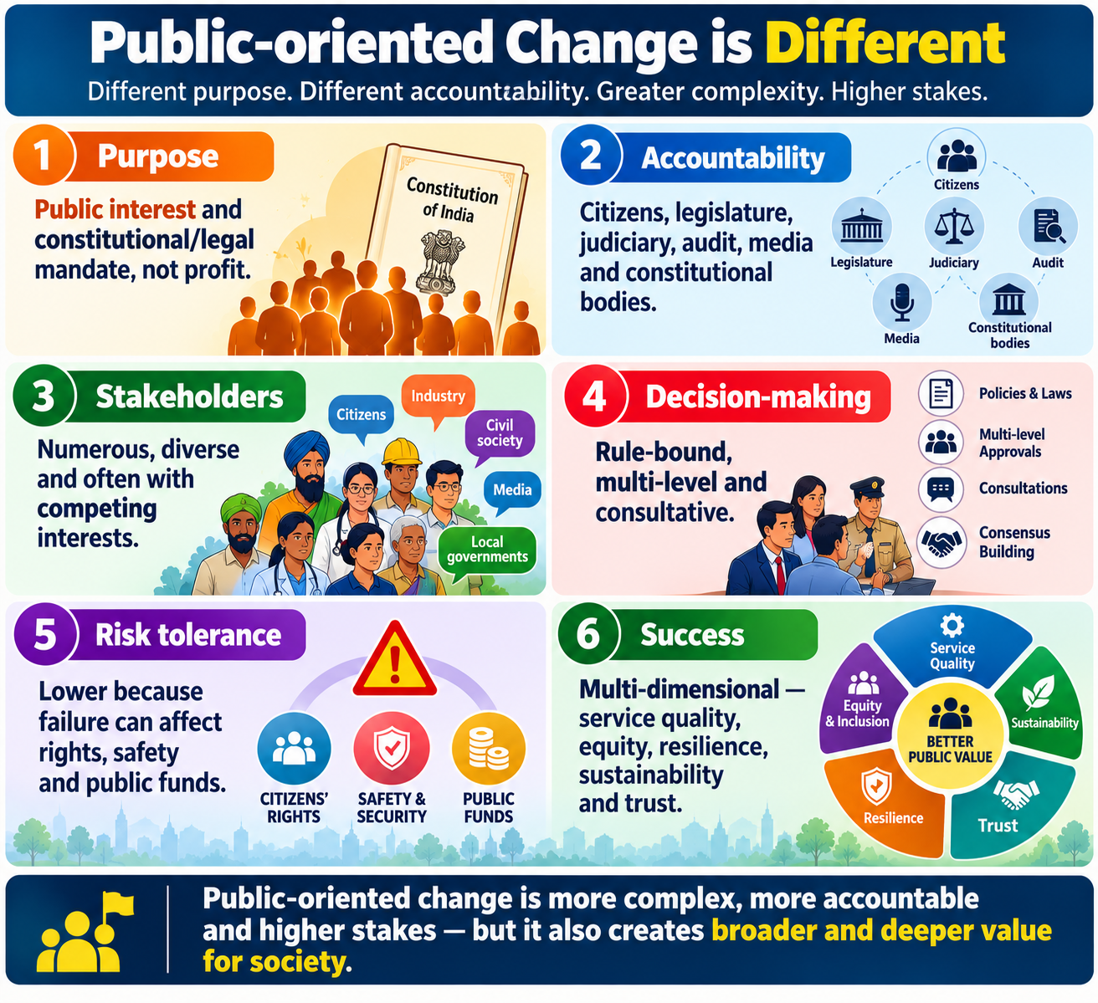
Public-oriented Change is Different
8
FOUNDATIONS
Purpose: public interest and constitutional/legal mandate, not profit.
Accountability: citizens, legislature, judiciary, audit, media and constitutional bodies.
Stakeholders: numerous, diverse and often with competing interests.
Decision-making: rule-bound, multi-level and consultative.
Risk tolerance: lower because failure can affect rights, safety and public funds.
Success: multi-dimensional—service quality, equity, resilience, sustainability and trust.
PRIVATE
PUBLIC
1
1
Profit / competition
Public interest
2
2
Faster decisions
Multi-level accountability
3
3
Higher risk tolerance
Equity + trust + resilience
Prof Anil Kumar | NITTTR | Training for Class-II Officers, Government of Bihar
APPLY • MEASURE • LEARN • SUSTAIN

Slide 11
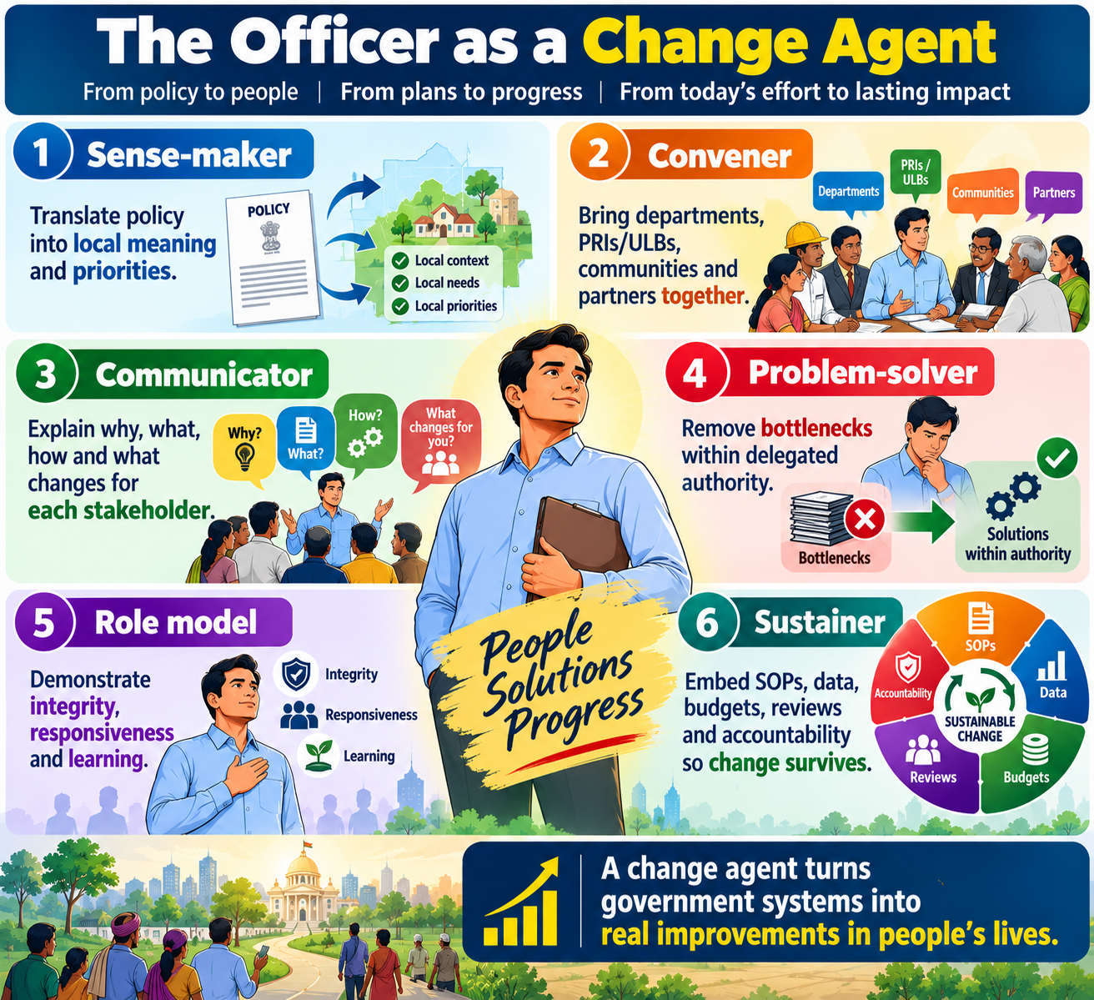
The Officer as a Change Agent
9
LEADERSHIP
Sense-maker
Sense-maker — translate policy into local meaning and priorities.
Convener — bring departments, PRIs/ULBs, communities and partners together.
Communicator — explain why, what, how and what changes for each stakeholder.
Problem-solver — remove bottlenecks within delegated authority.
Role model — demonstrate integrity, responsiveness and learning.
Sustainer — embed SOPs, data, budgets, reviews and accountability so change survives.
Sustainer
Convener
CHANGE
LEADER
Role model
Communicator
Problem-solver
Prof Anil Kumar | NITTTR | Training for Class-II Officers, Government of Bihar
APPLY • MEASURE • LEARN • SUSTAIN

Slide 12
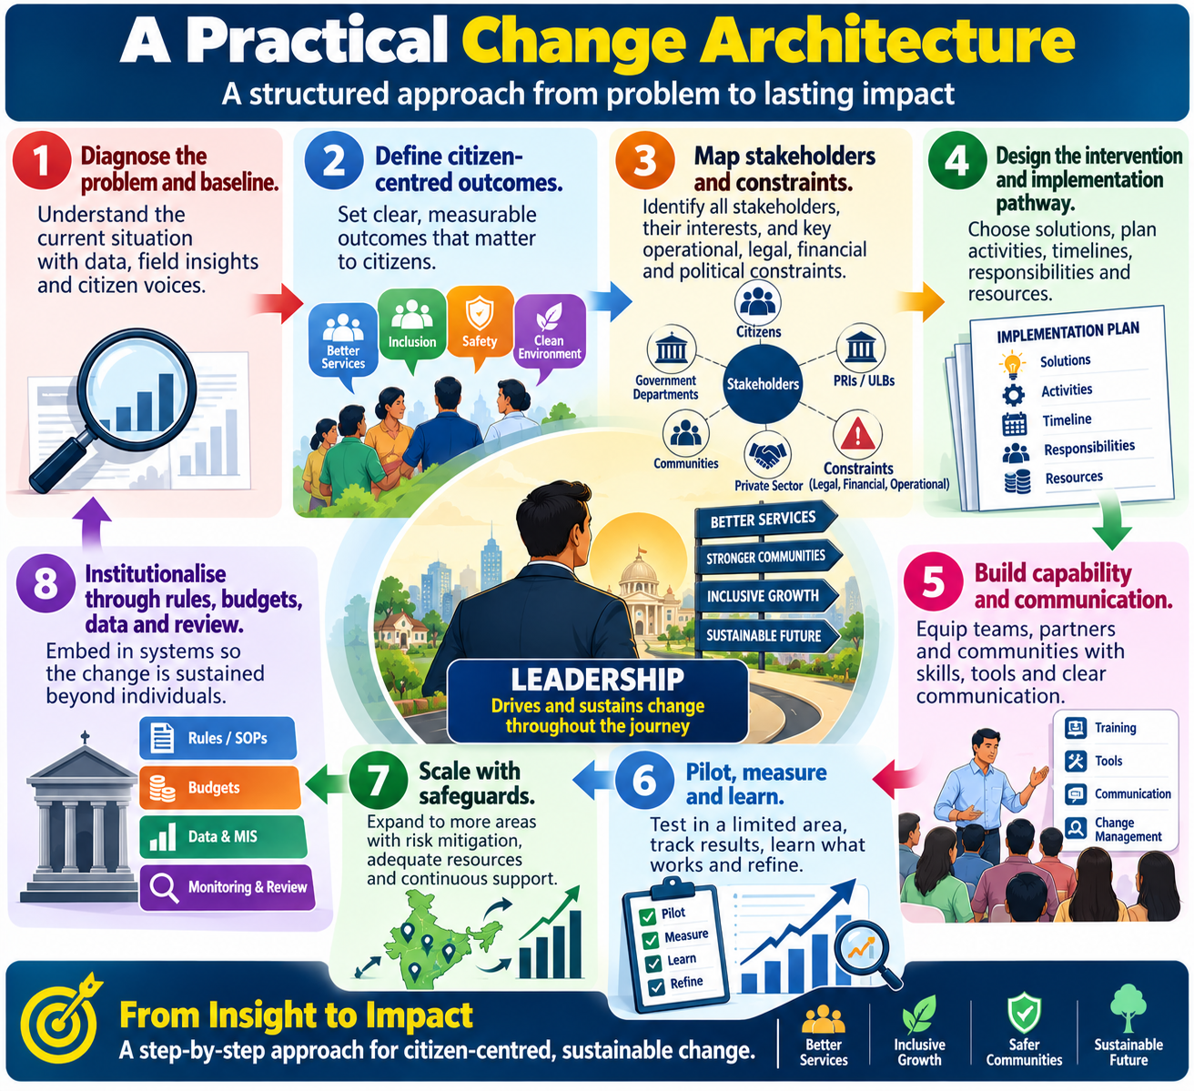
A Practical Change Architecture
10
LEADERSHIP
1
2
1. Diagnose the problem and baseline.
2. Define citizen-centred outcomes.
3. Map stakeholders and constraints.
4. Design the intervention and implementation pathway.
5. Build capability and communication.
6. Pilot, measure and learn.
7. Scale with safeguards.
8. Institutionalise through rules, budgets, data and review.
Diagnose
Define outcome
3
4
Map
Design
5
6
Build capability
Pilot & learn
7
8
Scale
Institutionalise
Prof Anil Kumar | NITTTR | Training for Class-II Officers, Government of Bihar
APPLY • MEASURE • LEARN • SUSTAIN

Slide 13
Kotter’s 8-Step Model — Public Administration Lens
11
MODELS
Create urgency using evidence and citizen impact.
Build a guiding coalition across functions and levels.
Form a clear vision and measurable outcomes.
Mobilise officers, frontline staff, community leaders and partners.
Remove procedural, capability and resource barriers.
Generate short-term wins.
Sustain acceleration and solve harder bottlenecks.
Institutionalise change in SOPs, budgets, MIS and performance reviews.
8. Institutionalise
7. Accelerate
6. Quick wins
5. Remove barriers
4. Mobilise
3. Vision
2. Coalition
1. Urgency
Prof Anil Kumar | NITTTR | Training for Class-II Officers, Government of Bihar
APPLY • MEASURE • LEARN • SUSTAIN

Slide 14
ADKAR — Change Happens One Person at a Time
12
MODELS
Awareness — Why is the change necessary?
Desire — Why should I support or participate?
Knowledge — What do I need to know?
Ability — Can I perform the new behaviour in real conditions?
Reinforcement — What will keep the new behaviour going?
KNOWLEDGE
AWARENESS
→
DESIRE
→
→
ABILITY
→
REINFORCE
Prof Anil Kumar | NITTTR | Training for Class-II Officers, Government of Bihar
APPLY • MEASURE • LEARN • SUSTAIN

Slide 15
Lewin + Bridges — Managing the Human Transition
13
MODELS
Lewin: Unfreeze → Change → Refreeze.
Bridges: Ending → Neutral Zone → New Beginning.
Administrative lesson: announcing a new order changes the formal system immediately; people’s habits, confidence and identity change more slowly.
Leaders must acknowledge loss, provide clarity during uncertainty, and reinforce the new normal.
FORMAL CHANGE
Unfreeze
→
Change
→
Refreeze
HUMAN TRANSITION
New beginning
Ending
→
Neutral zone
→
Prof Anil Kumar | NITTTR | Training for Class-II Officers, Government of Bihar
APPLY • MEASURE • LEARN • SUSTAIN

Slide 16
Stakeholder Mapping
14
STAKEHOLDERS
Identify everyone affected: citizens, frontline staff, supervisors, elected representatives, PRIs/ULBs, civil society, vendors, media and other departments.
Assess power, interest, impact, likely position and concerns.
Power–interest grid: Manage Closely • Keep Satisfied • Keep Informed • Monitor.
Design engagement—not merely communication—for high-impact stakeholders.
KEEP SATISFIED
MANAGE CLOSELY
POWER
MONITOR
KEEP INFORMED
INTEREST →
Prof Anil Kumar | NITTTR | Training for Class-II Officers, Government of Bihar
APPLY • MEASURE • LEARN • SUSTAIN

Slide 17
Resistance is Data
15
STAKEHOLDERS
Listen before persuading.
Separate misinformation from valid objections.
Involve credible frontline champions.
Pilot and demonstrate benefits.
Escalate only after reasonable engagement and problem-solving.
Treat resistance first as diagnostic information, not disobedience.
RESISTANCE
→
DIAGNOSE
RESPOND
LEARN
→
→
Fear • workload • incentives • capability • trust • design risk
Prof Anil Kumar | NITTTR | Training for Class-II Officers, Government of Bihar
APPLY • MEASURE • LEARN • SUSTAIN

Slide 18
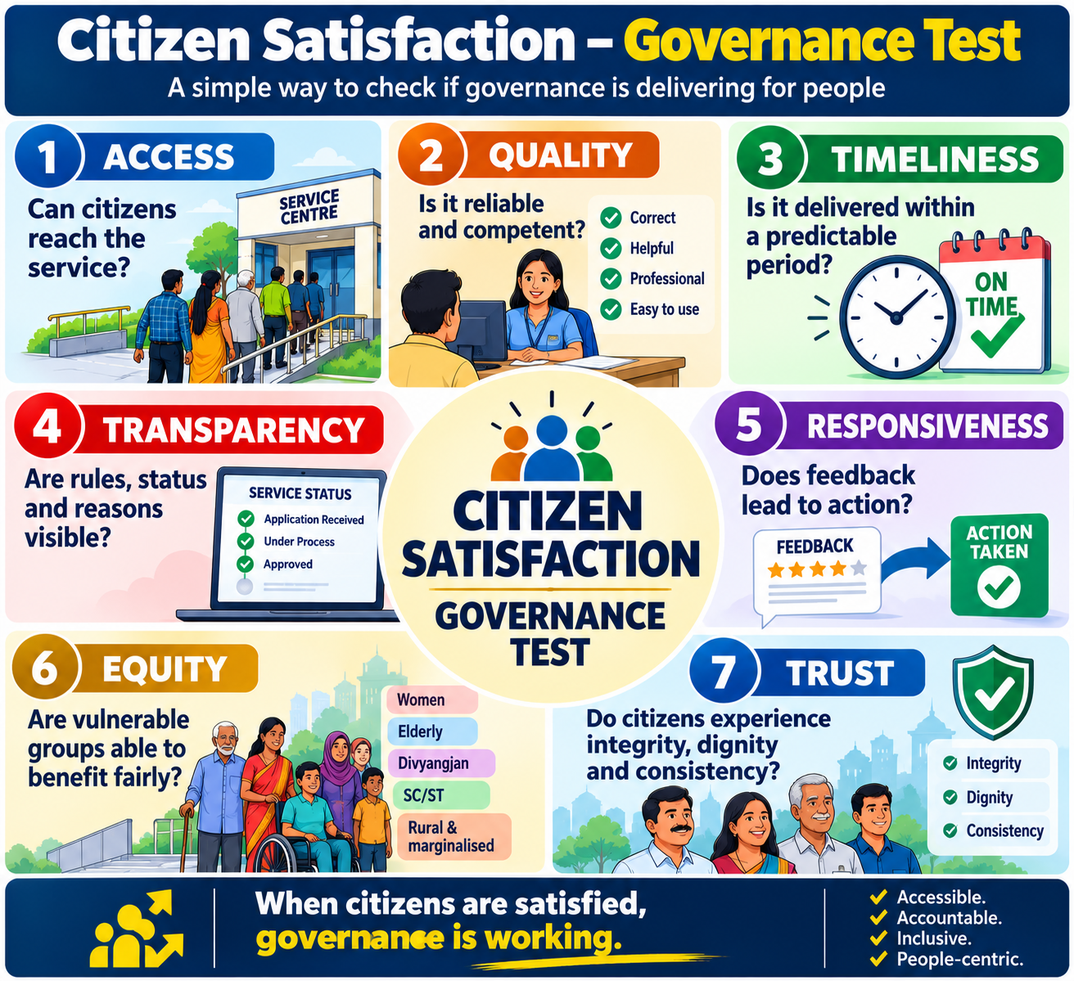
Citizen Satisfaction: The Governance Test
16
CITIZEN-CENTRIC GOVERNANCE
Access
Access — can citizens reach the service?
Quality — is it reliable and competent?
Timeliness — is it delivered within a predictable period?
Transparency — are rules, status and reasons visible?
Responsiveness — does feedback lead to action?
Equity — are vulnerable groups able to benefit fairly?
Trust — do citizens experience integrity, dignity and consistency?
Trust
Quality
CHANGE
LEADER
Equity
Timeliness
Response
Transparency
Prof Anil Kumar | NITTTR | Training for Class-II Officers, Government of Bihar
APPLY • MEASURE • LEARN • SUSTAIN

Slide 19
Measure the Citizen Journey
17
CITIZEN-CENTRIC GOVERNANCE
Map the journey: awareness → application → verification → decision → delivery → grievance/appeal.
Track citizen effort: visits, documents, waiting time, out-of-pocket cost and uncertainty.
Track system performance: turnaround time, pendency, error/rework, coverage and grievance resolution.
Disaggregate by gender, geography, disability, socio-economic group and digital access where appropriate.
Awareness
Apply
Verify
Deliver
Grievance
→
→
→
Decide
→
→
1
Visits
2
Documents
3
Waiting
4
Cost
5
Errors
6
Satisfaction
Prof Anil Kumar | NITTTR | Training for Class-II Officers, Government of Bihar
APPLY • MEASURE • LEARN • SUSTAIN

Slide 20
Global Frameworks: One Integrated Governance Agenda
18
GLOBAL FRAMEWORKS
Paris Agreement: climate mitigation, adaptation and resilience.
2030 Agenda/SDGs: integrated social, economic and environmental development.
Sendai Framework: prevent new risk, reduce existing risk and strengthen resilience.
New Urban Agenda: inclusive, safe, resilient and sustainable settlements.
Mission LiFE and related initiatives: behaviour and lifestyle change.
Core convergence: development must be low-carbon, risk-informed, inclusive and measurable.
The three 2015 frameworks converge at local level: resilient, inclusive and measurable development.
SDGs
Development
PARIS
Climate
SENDAI
Risk
RESILIENT + INCLUSIVE + MEASURABLE GOVERNANCE
Prof Anil Kumar | NITTTR | Training for Class-II Officers, Government of Bihar
APPLY • MEASURE • LEARN • SUSTAIN

Slide 21
Paris Agreement — What Officers Need to Know
19
GLOBAL FRAMEWORKS
Adopted in 2015; legally binding international treaty on climate change.
Temperature goal: hold warming well below 2°C and pursue efforts toward 1.5°C above pre-industrial levels.
Countries communicate Nationally Determined Contributions (NDCs) and strengthen action over time.
Local relevance: infrastructure, water, agriculture, health, urban services, energy, ecosystems and disaster management all shape climate resilience.
<2°C
PURSUE 1.5°C
1
Mitigation
2
Adaptation
3
Resilience
4
NDC cycle
Prof Anil Kumar | NITTTR | Training for Class-II Officers, Government of Bihar
APPLY • MEASURE • LEARN • SUSTAIN

Slide 22
India’s NDC 2031–2035 — Governance Implications
20
GLOBAL FRAMEWORKS
Reduce emissions intensity of GDP by 47% by 2035 from 2005 level.
Achieve about 60% cumulative electric power installed capacity from non-fossil fuel sources by 2035.
Create a carbon sink of 3.5–4.0 billion tonnes CO₂e through forest and tree cover by 2035 versus 2005 baseline.
Enhance adaptation investment in vulnerable sectors including agriculture, water, health and disaster management.
Advance Mission LiFE, finance, technology and capacity building.
1
2
3
47%
Emissions intensity
60%
Non-fossil capacity
3.5–4.0 bn tCO₂e
Carbon sink
Officer implication: mainstream climate into infrastructure, water, agriculture, health and DRR.
Prof Anil Kumar | NITTTR | Training for Class-II Officers, Government of Bihar
APPLY • MEASURE • LEARN • SUSTAIN

Slide 23
2030 Agenda and SDGs
21
GLOBAL FRAMEWORKS
Adopted in 2015: 17 goals and 169 targets; integrated and indivisible.
Central promise: leave no one behind.
For officers, SDGs provide a results framework connecting departmental work to development outcomes.
High-relevance goals for Bihar include poverty, hunger, health, education, gender, water, decent work, inequality, sustainable cities, climate action and strong institutions.
1
2
PEOPLE
1–5
PROSPERITY
7–11
3
4
PLANET
6,12–15
PEACE
16
5
PARTNERSHIP
17
Prof Anil Kumar | NITTTR | Training for Class-II Officers, Government of Bihar
APPLY • MEASURE • LEARN • SUSTAIN

Slide 24
Localising the SDGs
22
GLOBAL FRAMEWORKS
Translate global goals into state, district, block, ULB and Panchayat priorities.
Link planning, budgeting, implementation and monitoring to measurable outcomes.
Use convergence: one local problem may require several departments and several SDGs.
NITI Aayog’s SDG India Index 2023–24 remains a key official national monitoring reference.
Use district and scheme data to identify gaps hidden by state averages.
GLOBAL
→
INDIA
→
BIHAR
→
DISTRICT
→
BLOCK / ULB
→
COMMUNITY
Localise goals → indicators → plans → budgets → review
Prof Anil Kumar | NITTTR | Training for Class-II Officers, Government of Bihar
APPLY • MEASURE • LEARN • SUSTAIN

Slide 25
Sendai Framework 2015–2030
23
DRR
Priority 1: Understand disaster risk.
Priority 2: Strengthen disaster risk governance.
Priority 3: Invest in DRR for resilience.
Priority 4: Enhance preparedness and Build Back Better.
Seven global targets focus on mortality, affected people, economic loss, critical infrastructure, DRR strategies, international cooperation and early warning/risk information.
1
2
1 Understand risk
2 Strengthen governance
3
4
4 Prepare + Build Back Better
3 Invest in resilience
7 targets: mortality • affected people • loss • infrastructure • strategies • cooperation • early warning
Prof Anil Kumar | NITTTR | Training for Class-II Officers, Government of Bihar
APPLY • MEASURE • LEARN • SUSTAIN

Slide 26
Risk-Informed Development
24
DRR
Disaster risk grows through the interaction of hazard, exposure, vulnerability and capacity.
Every development decision can reduce risk, transfer risk—or create new risk.
Screen projects for flood, heat, drought, seismic and other relevant hazards.
Protect critical services: health, water, power, roads, schools, communications and administrative continuity.
Use recovery as an opportunity to Build Back Better.
HAZARD
EXPOSURE
VULNERABILITY
RISK
→
→
→
1
Screen project
2
Reduce exposure
3
Strengthen capacity
4
Protect services
Prof Anil Kumar | NITTTR | Training for Class-II Officers, Government of Bihar
APPLY • MEASURE • LEARN • SUSTAIN

Slide 27
India’s Disaster Management Framework
25
DRR
Disaster Management Act, 2005, as amended in 2025.
National Disaster Management Plan (2016; revised 2019).
National Policy on Disaster Management, 2009.
NDMA/NIDM/NDRF at national level; SDMA/DDMA and local bodies at state/district/local levels.
The 2025 amendment strengthens institutional arrangements and enables Urban Disaster Management Authorities for state capitals and municipal corporation cities.
NATIONAL
NDMA/NIDM/NDRF
STATE
SDMA
DISTRICT
DDMA
LOCAL
ULB/PRI
→
→
→
Law + plans + institutions + data + preparedness + finance
Prof Anil Kumar | NITTTR | Training for Class-II Officers, Government of Bihar
APPLY • MEASURE • LEARN • SUSTAIN

Slide 28
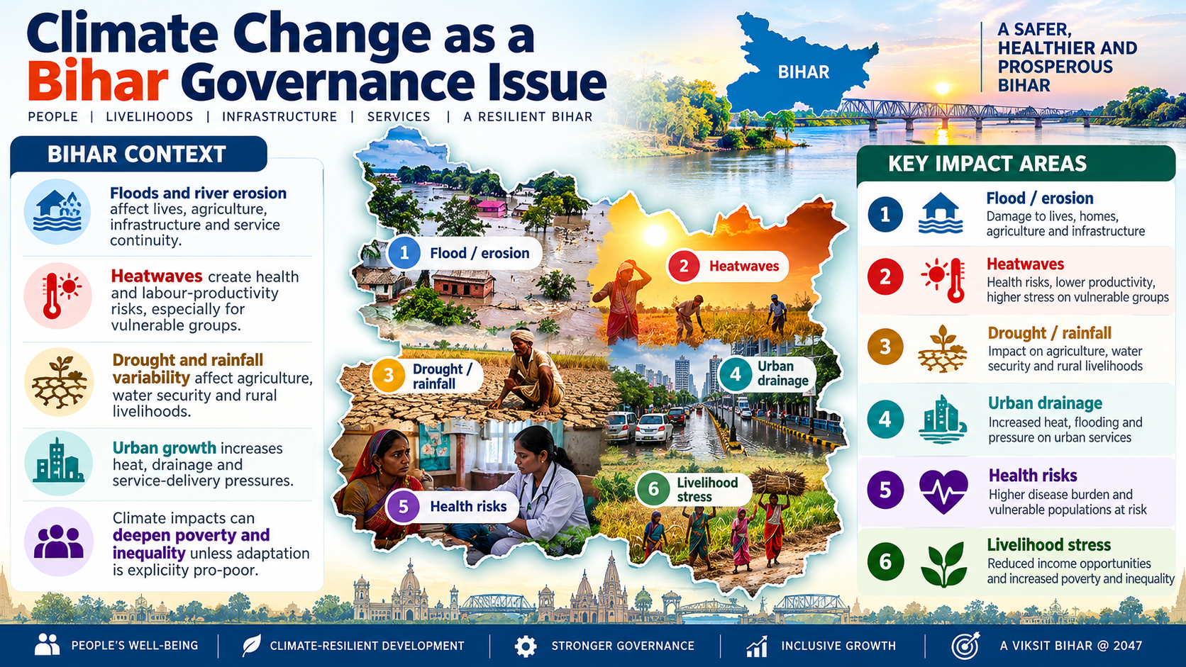
Climate Change as a Bihar Governance Issue
26
BIHAR CONTEXT
Floods and river erosion affect lives, agriculture, infrastructure and service continuity.
Heatwaves create health and labour-productivity risks, especially for vulnerable groups.
Drought and rainfall variability affect agriculture, water security and rural livelihoods.
Urban growth increases heat, drainage and service-delivery pressures.
Climate impacts can deepen poverty and inequality unless adaptation is explicitly pro-poor.
1
2
Flood / erosion
Heatwaves
3
4
Drought / rainfall
Urban drainage
5
6
Health risks
Livelihood stress
Prof Anil Kumar | NITTTR | Training for Class-II Officers, Government of Bihar
APPLY • MEASURE • LEARN • SUSTAIN

Slide 29
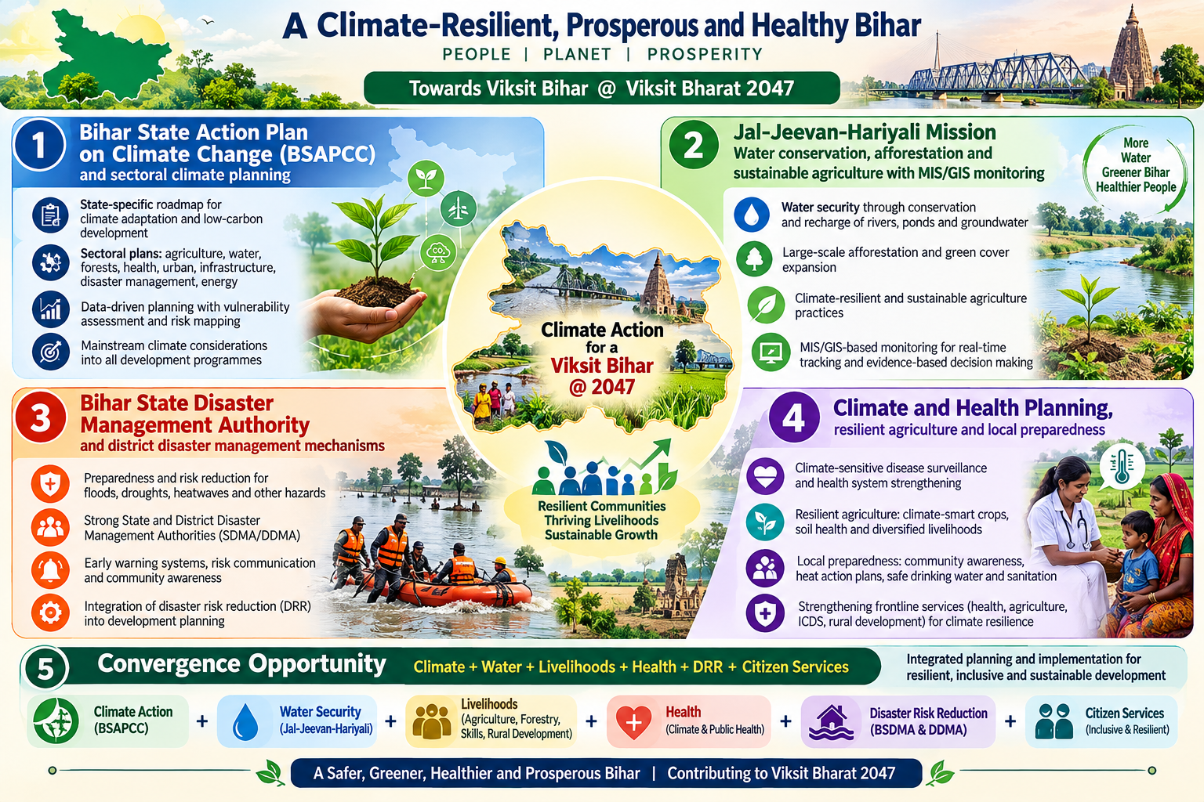
Bihar Climate and Sustainability Architecture
27
BIHAR CONTEXT
Bihar State Action Plan on Climate Change (BSAPCC) and sectoral climate planning.
Jal-Jeevan-Hariyali Mission: water conservation, afforestation and sustainable agriculture with MIS/GIS monitoring.
Bihar State Disaster Management Authority and district disaster management mechanisms.
Climate and health planning, resilient agriculture and local preparedness.
Convergence opportunity: climate + water + livelihoods + health + DRR + citizen services.
Climate
Citizen services
Water
CHANGE
LEADER
DRR
Livelihoods
Health
Prof Anil Kumar | NITTTR | Training for Class-II Officers, Government of Bihar
APPLY • MEASURE • LEARN • SUSTAIN

Slide 30
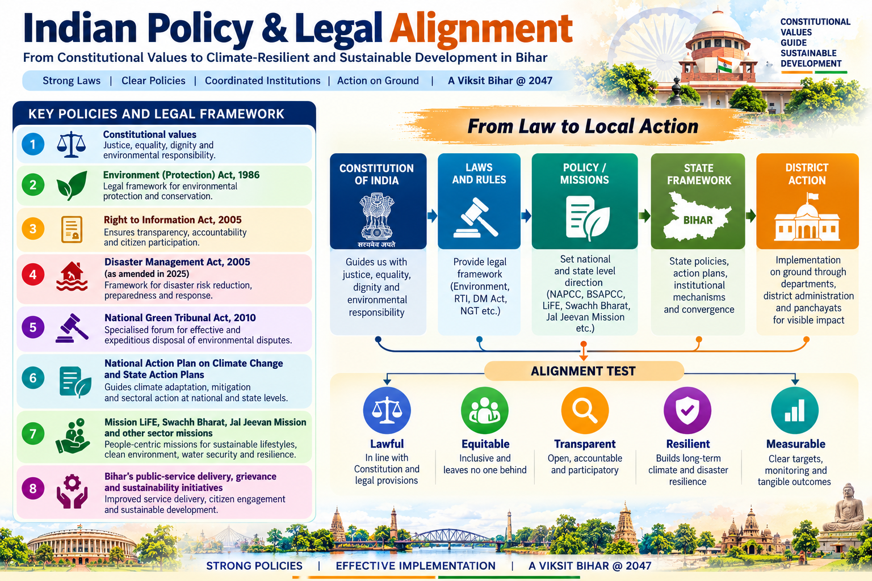
Indian Policy & Legal Alignment
28
POLICY ALIGNMENT
Constitutional values: justice, equality, dignity and environmental responsibility.
Environment (Protection) Act, 1986.
Right to Information Act, 2005.
Disaster Management Act, 2005 as amended in 2025.
National Green Tribunal Act, 2010.
National Action Plan on Climate Change and State Action Plans.
Mission LiFE, Swachh Bharat, Jal Jeevan Mission and other sector missions.
Bihar’s public-service delivery, grievance and sustainability initiatives.
CONSTITUTION
POLICY / MISSION
STATE FRAMEWORK
DISTRICT ACTION
→
LAW
→
→
→
Alignment test: lawful • equitable • transparent • resilient • measurable
Prof Anil Kumar | NITTTR | Training for Class-II Officers, Government of Bihar
APPLY • MEASURE • LEARN • SUSTAIN

Slide 31
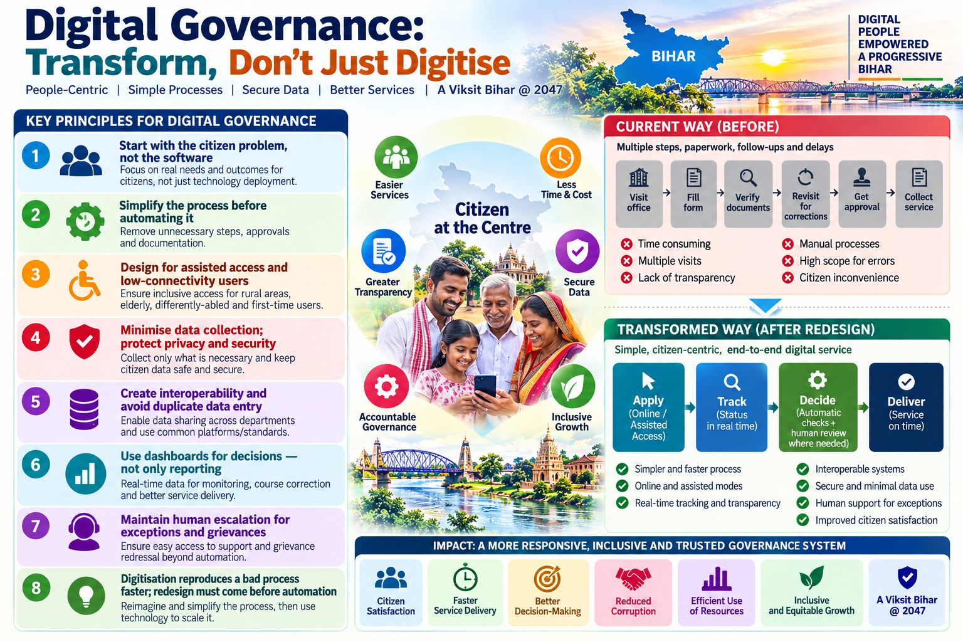
Digital Governance: Transform, Don’t Just Digitise
29
TRANSFORMATION TOOLS
Start with the citizen problem, not the software.
Simplify the process before automating it.
Design for assisted access and low-connectivity users.
Minimise data collection; protect privacy and security.
Create interoperability and avoid duplicate data entry.
Use dashboards for decisions—not only reporting.
Maintain human escalation for exceptions and grievances.
Digitisation reproduces a bad process faster; redesign must come before automation.
BEFORE
Visit
→
Form
→
Verify
→
Revisit
→
Approve
→
Collect
AFTER REDESIGN
Apply
→
Track
→
Decide
→
Deliver
Prof Anil Kumar | NITTTR | Training for Class-II Officers, Government of Bihar
APPLY • MEASURE • LEARN • SUSTAIN

Slide 32
Innovation in Government: Safe-to-Learn, Not Free-to-Fail
30
TRANSFORMATION TOOLS
Define the problem and non-negotiable legal/safety boundaries.
Generate options with frontline staff and citizens.
Pilot at limited scale with explicit success and stop criteria.
Collect quantitative and qualitative evidence.
Adapt based on learning.
Scale only when benefits, risks, costs and operating capacity are understood.
PROBLEM
PILOT
EVIDENCE
ADAPT
SCALE
→
→
→
→
Safe-to-learn = bounded risk + explicit stop criteria + evidence before scale
Prof Anil Kumar | NITTTR | Training for Class-II Officers, Government of Bihar
APPLY • MEASURE • LEARN • SUSTAIN

Slide 33
Community Participation and Co-production
31
COMMUNITY
Move from informing citizens to involving them in diagnosis, design, monitoring and maintenance.
Use Gram Sabha, ward-level platforms, SHGs, community-based organisations and local institutions appropriately.
Include women, youth, elderly persons, persons with disabilities and marginalised groups.
Make feedback visible: ‘You said → We did → Result’.
Community ownership is especially important for water, sanitation, resilience, livelihoods and behavioural change.
Participation increases ownership—and the quality of local information.
Co-produce
Collaborate
Involve
Consult
Inform
Prof Anil Kumar | NITTTR | Training for Class-II Officers, Government of Bihar
APPLY • MEASURE • LEARN • SUSTAIN

Slide 34
A Citizen-Centric Service Redesign Example
32
APPLICATION
Problem: citizens make repeated visits for a routine service.
Baseline: map visits, documents, processing time, rejection reasons and grievances.
Redesign: remove duplicate documents, clarify eligibility, enable status tracking, define escalation.
Adoption: train frontline staff; communicate to citizens; support assisted digital access.
Measure: turnaround time, first-time-right rate, visits per case, grievance rate and satisfaction.
Sustain: SOP, dashboard, monthly review and corrective action.
Repeated visits
Simplify documents
Status tracking
Escalation
Measure
→
→
→
→
Turnaround time
First-time-right
Visits/case
1
2
3
4
Grievance rate
5
Satisfaction
Prof Anil Kumar | NITTTR | Training for Class-II Officers, Government of Bihar
APPLY • MEASURE • LEARN • SUSTAIN

Slide 35
Case Study Workshop: Heatwave Resilience
33
CASE WORKSHOP
Challenge: rising heat risk affects health, outdoor workers, schools, water demand and urban services.
Change task: build a multi-department heat-risk management system.
Apply: risk mapping + early warning + health preparedness + water/cooling access + work/school protocols + public communication.
Stakeholders: district administration, ULB, health, education, labour, water, disaster management, communities and media.
Success: fewer heat-related impacts, timely alerts, high-risk area coverage and citizen awareness.
1
2
Risk map
Early warning
3
4
Health readiness
Water / cooling
5
6
Work-school protocols
Public communication
Prof Anil Kumar | NITTTR | Training for Class-II Officers, Government of Bihar
APPLY • MEASURE • LEARN • SUSTAIN

Slide 36
Case Study Workshop: Climate-Smart Rural Development
34
CASE WORKSHOP
Challenge: rainfall variability, flood/drought risk and livelihood vulnerability.
Change task: increase adoption of climate-resilient practices without imposing one-size-fits-all solutions.
Tools: demonstration plots, farmer champions, advisories, water management, resilient varieties, SHG/FPO linkages and convergence of schemes.
Change lesson: visible local evidence + trusted messengers + enabling finance/inputs can accelerate adoption.
Measure both adoption and outcomes: yield stability, water use, income resilience and inclusion.
Local evidence
Farmer champions
Climate risk
Adoption
Resilient livelihood
→
→
→
→
1
2
3
4
Yield stability
Water use
Income resilience
Inclusion
Prof Anil Kumar | NITTTR | Training for Class-II Officers, Government of Bihar
APPLY • MEASURE • LEARN • SUSTAIN

Slide 37
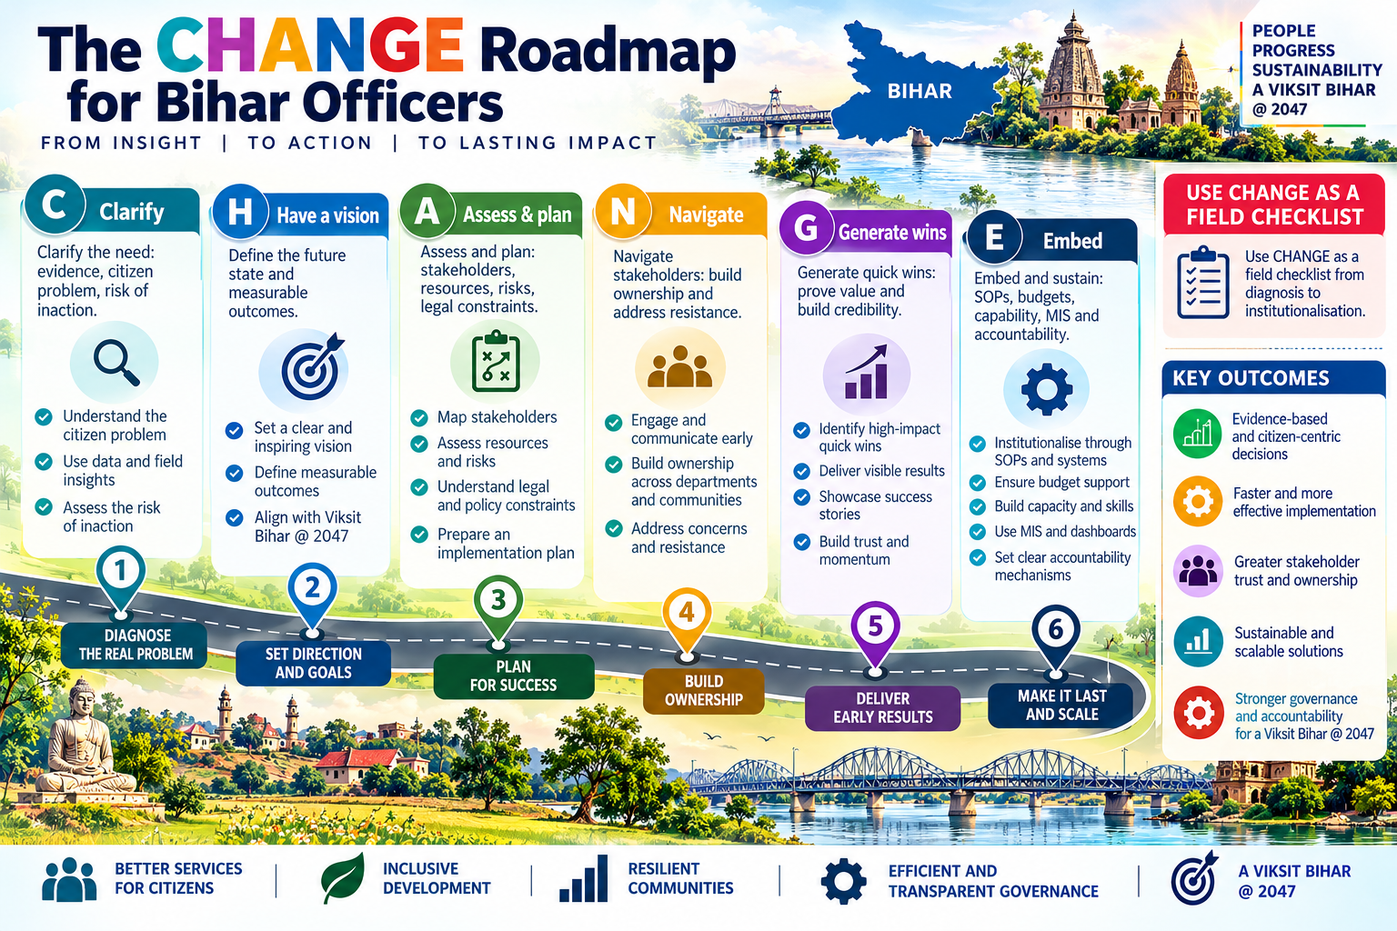
The CHANGE Roadmap for Bihar Officers
35
OFFICER TOOLKIT
C — Clarify the need: evidence, citizen problem, risk of inaction.
H — Have a vision: define the future state and measurable outcomes.
A — Assess and plan: stakeholders, resources, risks, legal constraints.
N — Navigate stakeholders: build ownership and address resistance.
G — Generate quick wins: prove value and build credibility.
E — Embed and sustain: SOPs, budgets, capability, MIS and accountability.
Use CHANGE as a field checklist from diagnosis to institutionalisation.
C
Clarify
H
Have a vision
A
Assess & plan
N
Navigate
G
Generate wins
E
Embed
Prof Anil Kumar | NITTTR | Training for Class-II Officers, Government of Bihar
APPLY • MEASURE • LEARN • SUSTAIN

Slide 38
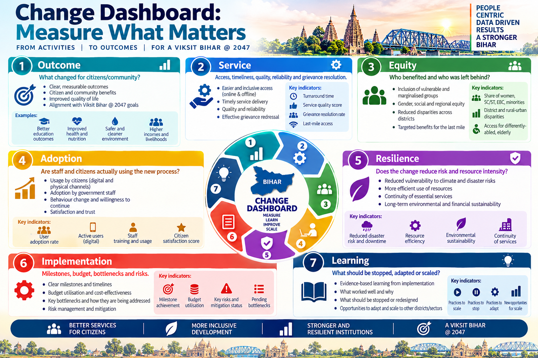
Change Dashboard: Measure What Matters
36
OFFICER TOOLKIT
Outcome: what changed for citizens/community?
Service: access, timeliness, quality, reliability and grievance resolution.
Equity: who benefited and who was left behind?
Adoption: are staff and citizens actually using the new process?
Resilience/sustainability: does the change reduce risk and resource intensity?
Implementation health: milestones, budget, bottlenecks and risks.
Learning: what should be stopped, adapted or scaled?
1
2
Outcome
Service
3
4
Equity
Adoption
5
6
Resilience
Implementation
7
Learning
Prof Anil Kumar | NITTTR | Training for Class-II Officers, Government of Bihar
APPLY • MEASURE • LEARN • SUSTAIN

Slide 39
WHY BIHAR NEEDS CHANGE MANAGEMENT
From scheme delivery to citizen outcomes
• Citizen-centred governance
• Human development first
Shift from files, approvals and expenditure to quality, access, equity and trust.
Improve learning, healthcare, nutrition, skills and women’s opportunities.
• Jobs and productive growth
• Convergence across government
Link agriculture, MSMEs, industry, entrepreneurship and youth employment.
Align departments, districts, PRIs/ULBs and communities around shared outcomes.
• Resilience and sustainability
• Evidence-based priorities
Integrate flood, heat, water, pollution and climate risks into development.
Use district baselines and SDG indicators to identify gaps and measure progress.
Viksit Bihar @ 2047 | Inclusive growth • Better services • Accountable institutions • Climate resilience

Slide 40
HOW OFFICERS CAN LEAD TRANSFORMATION
The change-management approach
• Build a shared case for change
• Set a clear 2047 direction
Explain the problem, urgency and benefits in simple language.
Translate Viksit Bihar goals into measurable district and service outcomes.
• Co-design with citizens
• Remove implementation barriers
Engage frontline staff, women, youth, vulnerable groups and local institutions.
Simplify rules, approvals and workflows; build skills and digital adoption.
• Pilot, learn and scale
• Institutionalise reforms
Test locally, measure citizen experience, show early wins and replicate what works.
Embed ownership, SOPs, budgets, data dashboards, reviews and accountability.
Viksit Bihar @ 2047 | Inclusive growth • Better services • Accountable institutions • Climate resilience

Slide 41
BIHAR @ 2047: FROM VISION TO RESULTS
A practical action agenda
• District-led transformation
• Outcome-based monitoring
Prepare district roadmaps with clear baselines, targets and accountable owners.
Track learning, health, jobs, service timeliness, inclusion and climate resilience.
• Whole-of-government delivery
• People and technology together
Create cross-department teams and resolve bottlenecks through regular reviews.
Use digital tools for transparent services—supported by trained staff and access.
• Climate-smart development
• Sustain gains beyond transfers
Prioritise flood/heat preparedness, water security, sustainable cities and farming.
Document practices, protect budgets, strengthen institutions and publish progress.
Viksit Bihar @ 2047 | Inclusive growth • Better services • Accountable institutions • Climate resilience

Slide 42
90-Day Change Leadership Plan
37
OFFICER TOOLKIT
Days 1–30: listen, observe, map the citizen journey, establish baseline, identify one priority problem.
Days 31–60: co-design a low-risk improvement, map stakeholders, build coalition, train and communicate.
Days 61–90: pilot, measure, collect feedback, correct design and document the SOP.
At Day 90: decide—stop, adapt, scale or institutionalise.
DAYS 1–30
Listen • map • baseline
DAYS 31–60
Co-design • coalition • train
DAYS 61–90
Pilot • measure • correct
DAY 90
Stop • adapt • scale • institutionalise
Prof Anil Kumar | NITTTR | Training for Class-II Officers, Government of Bihar
APPLY • MEASURE • LEARN • SUSTAIN

Slide 43
Action Learning Exercise
38
ACTION LEARNING
Choose one real problem from your department/posting.
Write a one-sentence citizen-centred problem statement.
Identify baseline evidence and affected groups.
Map five critical stakeholders.
Select a change model/tool.
Define one 90-day pilot and three success indicators.
Identify one climate/DRR/SDG linkage.
Plan how the improvement will be institutionalised.
1
Problem statement
2
Baseline evidence
3
4
Affected groups
5 stakeholders
5
6
Change tool
90-day pilot
7
8
Climate/DRR/SDG link
3 indicators
Prof Anil Kumar | NITTTR | Training for Class-II Officers, Government of Bihar
APPLY • MEASURE • LEARN • SUSTAIN

Slide 44
Key Takeaways
39
SUMMARY
Change management is a leadership discipline, not a one-time project.
Citizen experience and public outcomes are the ultimate test.
Climate, sustainability and disaster risk must be mainstreamed into development decisions.
Global frameworks become meaningful only when local plans, budgets, services and behaviours change.
Data, participation, capability and trust are core implementation assets.
Start small where appropriate, learn quickly, scale responsibly and institutionalise relentlessly.
1
2
Lead change
Start with citizens
3
4
Mainstream resilience
Localise frameworks
5
6
Learn → scale → sustain
Use data + trust
Prof Anil Kumar | NITTTR | Training for Class-II Officers, Government of Bihar
APPLY • MEASURE • LEARN • SUSTAIN

Slide 45
References & Further Reading
40
REFERENCES
UNFCCC — Paris Agreement; India NDC 2031–2035 (submitted 24 April 2026).
United Nations — Transforming our World: 2030 Agenda; SDG platform.
UNDRR — Sendai Framework for Disaster Risk Reduction 2015–2030.
NITI Aayog — SDG India Index 2023–24; SDG localisation resources.
MoEFCC — National Action Plan on Climate Change and climate policy resources.
MHA / NIDM — Disaster Management Act, 2005; Amendment Act, 2025; NDMP.
Government of Bihar — Jal-Jeevan-Hariyali Mission; BSAPCC/sectoral climate resources; BSDMA resources.
Kotter, J.P. — Leading Change; Hiatt, J. — ADKAR; Bridges, W. — Managing Transitions.
1
UNFCCC / Paris / India NDC
2
UN 2030 Agenda / SDGs
3
4
NITI Aayog SDG Index
UNDRR / Sendai
5
6
MHA / NDMA / NIDM
MoEFCC / NAPCC
7
Govt. of Bihar / BSDMA
8
Kotter • ADKAR • Bridges
Prof Anil Kumar | NITTTR | Training for Class-II Officers, Government of Bihar
APPLY • MEASURE • LEARN • SUSTAIN

