Slide 1

TAX DEDUCTION AT SOURCE (TDS)
Income Tax Act 1961
SUDHANSHU KUMAR JHA
CHARTERED ACCOUNTANT

Slide 2
What is TDS ?
Tax Deducted at Source is a mean of collecting income tax in India, under the Indian Income Tax Act of 1961. Any payment covered under these provisions shall be paid after deducting at prescribed percentage / rate.
The government uses TDS as a tool to collect tax evasion by taxing the income ( partially or wholly) at the time it is generated rather than at a later date.

Slide 3
Income from salary
TDS is applicable on the various incomes such as salaries,business/profession, interest received, Capital Gain, etc
DEDUCTION OF TAX AT SOURCE FROM SALARY
Scope and application of Section 192
Section 192 provides that any person responsible for paying any income chargeable

Slide 4
Under the head ‘Salaries’ is required to deduct tax on the amount payable.
What payments are covered by Section 192
Payment is made generally by the employer to the employee.
-Payment is in the nature of ‘salary’.
Payers , who are covered under section 192
The Payer will be the employer, but in certain exceptional cases, it may be a person other than.

Slide 5
the employer who is designated for this purpose.
PERSON, CONNOTATION OF – Section 2(31) of the Income Tax Act defines the term ‘person’ to include the folloeing:
Individual
Hindu undivided family ( HUF )

Slide 6
Firm
Company
Association of Persons (AOP)
Body of Individuals ( BOI)
Local authority

Slide 7
Payees, who are covered by section 192
Any Individual (known as ‘employee’ in common parlance) who receives any payment from his employer or from any other designated authority on behalf of the employer which is chargeable under the head ‘Salaries’ is covered by section 192.Pension is also ‘Salary’ , and though it is not received from ‘employed’, pensioners are also covered u/s 192.

Slide 8
WHEN TAX IS TO BE DEDUCTED ?
Tax is to be deducted at the time of payment of salary, i.e., tax is to be deducted at the time of ‘actual payment’ of the salary.
Who is to deduct tax at source in case of ‘ Salary’
Any ‘person’ responsible for paying any income chargeable under the head ‘Salaries’ is required to deduct tax from the salary so payable.

Slide 9
Quarterly Deposit of tax
In special cases, the Assessing Officer may, with the prior approval of the Joint Commissioner, permit quarterly payment of the tax deducted as per Table given below :

Slide 10
Sl.No. Qtr of the Date for Qtr
F.Y.ended on payment
1. 30th June 7th July
2. 30th September 7th October
3. 31th December 7th January
4. 31th March 30th April

Slide 11
How to Deposit Tax
(1) Where tax has been deposited accompanied by an income-tax challan, the amount of tax so deducted shall be deposited to the credit of the Central Government by remitting it within the time specified into any branch of the Reserve Bank if India or of the State Bank of India or any authorized bank;

Slide 12
Which challan to be used
The tax deducted at source is required to be deposited in Challan.281.
Penalty for non- issue of certificate
If an employer fails to issue certificate in Form No.16, he shall be liable to pay, by way of penalty, a sum of Rs. 200 for every day during which the failure continues, subject to a maximum of the amount of tax deducted at source for which certificate is required to be issued.

Slide 13
Furnishing of statements by employer to department
In respect of tax deducted at source , or tax paid by employer on behalf of employee in respect of perquisites, every employer is required to prepare and transmit quarterly statements in the manner explained below:
Form of the quarterly statement.

Slide 14
Quarterly Return of TDS on salary 24Q
The statement must be prepared I Form No.24Q.
The following points must be noted while preparing the quarterly statements:
The employer must quote his tax deduction and collection account number (TAN) in the statement.
The employer must quote his permanent account number (PAN) in the statement except in the case where the deductor is an office of the Government.

Slide 15
Quarterly Return of TDS on salary 24Q
The Employer must quote the permanent account number of all deductees.
The employer must furnish particulars of the tax paid to the Central Government including book identification number or challan identification number , as the case may be.
Quarterly return cannot be submitted before deposit of TDS and interest (for late deposit) u/s 201as well as fees levied u/s 234E.

Slide 16
Penalty for non providing pan
TAN of the deductor should be quoted correctly, otherwise a penalty of Rs. 1000 can be imposed by the Assessing Officer.
A deductee should intimate his PAN to the deductor. Failure to do so may attract penalty of Rs. 10000 on deductee.
If the recipient does not furnish PAN,tax will be deducted u/s 192A at the max. marginal rate of tax (i.e.42.744 % F.Y. 2019-20.) and not at the rate of 20%.

Slide 17
DEDUCTION OF TAX AT SOURCE FROM PAYMENTS TO CONTRACTORS/ SUB- cONTRACTORS
Scope and application of section 194C
Any person responsible for paying any sum to any resident for carrying out any work in pursuance of a contract between the contractor

Slide 18
194 c: Payment to contractor
and a ‘ specified person’ will be liable to deduct tax at source at the prescribed rates. The term ‘contract’ will include a sub- contract also.
Meaning of ‘specified person’
The term ‘ specified person’
The Central Government or any State Government
Any local authority.

Slide 19
Persons required to deduct tax from contractor
Any corporation established by or under a Central Act or State Act or Provincial Act.
Any Company
Any Co-operative society.
Any authority constituted in India by or under any law, engaged for the purpose of dealing with and satisfying the need for housing accommodation or for the purpose of planning ,development or improvement

Slide 20
Persons required to deduct tds from contractor
of cities, towns and villages or for both.
Any society registered under the Society Registration Act, 1860 or under any law corresponding to that Act in force in any part of India.
Any Trust
Any university established or under Central, state or Provincial Act and an institution declared to be a university under section 3

Slide 21
Persons required to deduct tax from contractor
of the University Grants Commission Act, 1956.
Any Government of a foreign State or a foreign enterprise or any association or body established outside outside India.
Any firm. The term ‘firm’ will include a limited liability partnership as defined in the LLP Act,2008

Slide 22
194 C : TDS on contractor
What payments are covered by section 194C
Section 194C is applicable in relation to payments for any work (including supply of labour for carrying out any work). Provisions of section 194C relating to tax deduction from payment to contractors are applicable only where contract is either a ‘work contract’ or a ‘ contract for supply of labour for works contract’.

Slide 23
194 C: Works contract tds
Who is responsible to deduct tax
The ‘payer’ is responsible to deduct tax at source.
When tax to be deducted
Tax is to be deducted either (a) at the time of credit such sum to the account of the payee, or (b) or the time of payment thereof in cash or by

Slide 24
TDS on works contract
issue of cheque or by any other mode, whichever is earlier.
Which challan to be used
The tax deducted at source is required to be deposited in Challan no.281

Slide 25
DEDUCTION OF TAX AT SOURCE FROM FEES FOR PROFESSIONAL OR TECHNICAL SERVICES.
Scope and effect of section 194J
Section 194J, as amended by the Finance Act,2012 provides for deduction of tax at source on any sum payable to a resident by way of deduction of tax at source on any sum payable to a resident by way of

Slide 26
194: Income from professional or technical services.
Fees for professional services or
Fees for technical services or
Any sum payable as royalty or any sum referred to in section 28 of the Act, generally known as ‘non – compete fees’
Payments covered by section 194J
Tax is required to be deducted at source on –

Slide 27
194 J : Income from Professional or technical services.
Any payment by way of fees for professional services,or
Any payment by way of fees for professional services, or
Any payment by way of fees for technical services, or
Any payment by way of royalty,or
Any payment by way of non- compete fees

Slide 28
TDS on Director Remuneration
Any remuneration or fees or commission by whatever name called, other than those on which tax is deductible under section 192, paid to a director of a company.
Who is to deduct tax at source
The payer is to deduct tax at source.

Slide 29
TDS for the services of director
When tax is to be deducted at source
Tax must be deducted at that point of time at which any of the following events occur first:
At the time of credit of the sum to the account of the payee.
At the time of payment in cash or by issue of the cheque or draft or by any other mode.
When the sum is credited to any account, whether called ‘Suspense Account’ or by any

Slide 30
Contd…
other name, in books of account of the payer.
Certificate/ statement for tax deducted at source
In respect of tax deducted at source during the financial year, the payer should furnish to the payee a certificate for tax deducted at source in Form no. 16 A

Slide 31
Form 16 A to be issued : Time schedule
Time within which certificate is to be issued
The certificate shall be furnished quarterly within the time limit specified below:
Quarter of the F.Y. ended | Due date
30th June | 30th July of the F.Y.
30th September | 30th October of the F.Y.
31st December | 30th January of the F.Y.
31st March | 30th May of the F.Y. immediately Following the F.Y. in which deduction is made.

Slide 32
APPLICATION OF TAN( ONLINE)
Step 1 –Visit https://tin.tin.nsdl.com/tan/index.html and select ‘Online Application for TAN ( form 49B)
Step 2 - Select Category of Deductors from the drop down menu and click on "Select Button“
Step 3 - Fill out the requisite details on the form (Fill all mandatory fields (marked with *));
Step 4 -If the data submitted by applicant fails in any format level validation, a response indicating the error(s) will be displayed on the screen

Slide 33
TAN Application
Step 5 - Forms need to be re-submitted after rectifying the error(s); In case form level error(s) do not exists a confirmation screen with data filled by the applicant will be displayed.
Step 6 - In case applicant required any amendment to the data displayed in the confirmation screen, it may choose the edit option

Slide 34
Step 7 -In case the displayed information is correct, applicant shall choose the confirm option.
Step 8 - On successful payment of Fees (in case the mode of payment is other than DD or Cheque) an acknowledgment slip will be generated

Slide 35
Contd…tan application
Step 8 - Applicant shall save and print the acknowledgment and send it to NSDL alongwith requisite documents at
NSDL e-Governance Infrastructure Limited,
5th floor, Mantri Sterling,
Plot No. 341, Survey No. 997/8,
Model Colony,
Near Deep Bungalow Chowk,
Pune – 411016

Slide 36
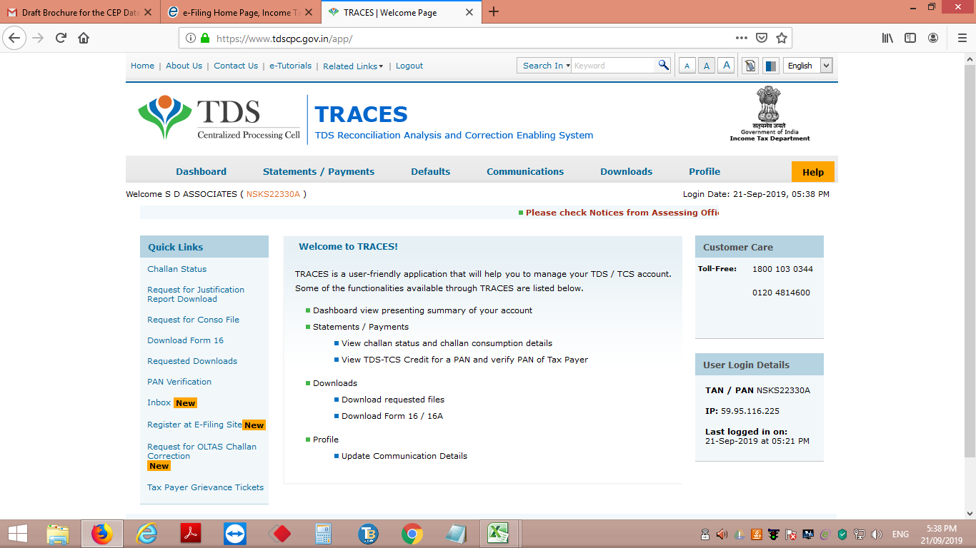
Screen shot of Site.

Slide 37
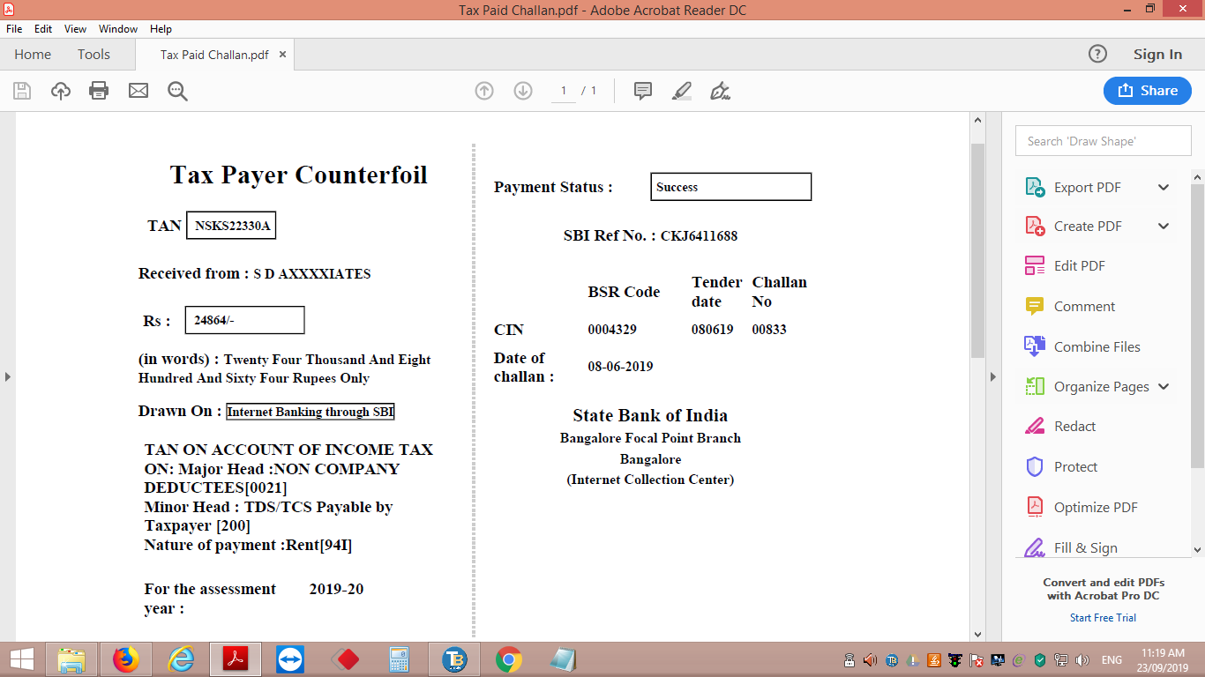
Screen shot of challan

Slide 38
THANK YOU

